Slide 1

SCREEN-LESS
DISPLAY
SUBMITTED TO :
Mr. ASHUTOSH MISHRA
SUBMITTED BY :
TEJASWITA (2001870100120)
VANSHIKA YADAV (2001870100129)

Slide 2
INITIMATION
01
What is SCREENLESS
DISPLAY
02
ORIGIN
3D DISPLAY
PROJECTION
TECHNOLOGY
03
View Slides
04
TYPES OF
DISPLAYS
05
PROJECTION WINDOW
06
RETINAL DISPLAY
08
07
AFFECTS OF SCREENLESS DISPLAY
ADVANTAGES

Slide 3
WHAT IS SCREENLESS DISPLAY?
1
Screenless Display is the present evolving technology in the field of the computer enhanced technologies.
It is going to be one of the greatest technological development in the coming future years.
Screen less display technology has the main aim of displaying or transmitting the information without any help of the screen or the projector.
Screen less displays have become a new range of development for the next GEN-X.
Screenless videos describe systems for transmitting visual information from a video source without the use of the screen.
2
3
4
5

Slide 4










ORIGIN OF SCREENLESS DISPLAY
Reto Meier predicts that 10 years from now we will be able to get transparent LCD patches that will adhere to our eyeglasses 20 years from now we’ll have contact lenses that project images directly onto our retinas and that we will be able to interface with computers through mind control.
The most profound effect will come from the development of the synaptic interface technology. This technology will allow people who are visually impaired to see just as the hearing impaired are able to hear through cochlear implants.

Slide 5


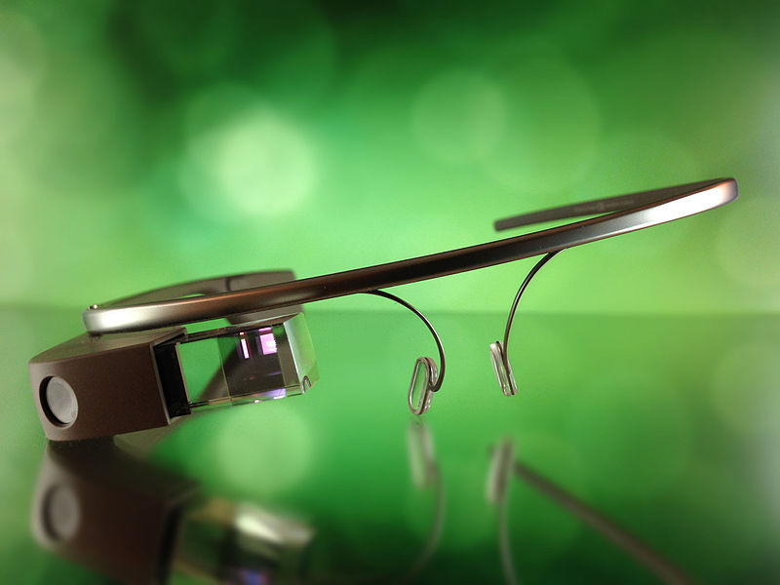
FIRST SCREEN-LESS DISPLAY
The first screen-less display that needs mentioning is Google Glass. Google Glass sits on the face like a pair of glasses, and on one eye it has a block of glass that allows you to see augmented reality. Images can be displayed right in front of your eyes , as well as text and information about objects and places that are infront of you. This technology is only in its early stages, but definitely shows that screen-less displays will become a natural form of media consumption in the future.

Slide 6


THE SIXTHSENSE TECHNOLOGY
It is a wearable gestural interface that augments the physical world around us with digital information and let us use natural hand gestures to interact with that information.
In this technology user is able to interact with a three dimensional image projected into thin air. Imagine your desktop floating in the space before your eyes waiting for your interactions!

Slide 7
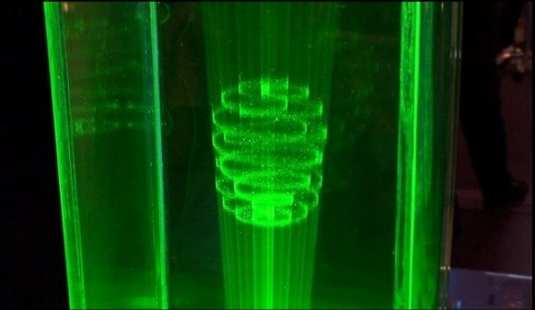
TECHNOLOGY USED IN SCREENLESS DISPLAY
Interactive Projection and Visual Display System

Slide 8

3D Display Projection Technology
With the large influx of new displays into the market boasting ‘ 3D supp ’ ,
We will look at the two main techniques being used today those being active
Shutter and polarization technologies. We will also discuss the trend in desktop
displays from a 3D point of view as well as looking at the other aspects being
developed to support 3D , such as Panel Technology.

Slide 9
TYPES OF DISPLAYS
Screenless computing systems can be divided into three groups :
Visual Image
Retinal Projection
Synaptic Interface / Brain Computer Interface

Slide 10




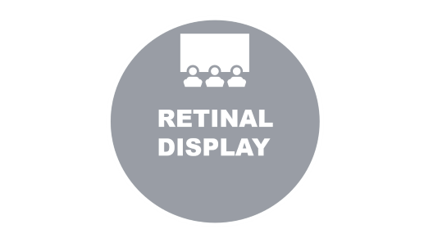

SLIDE ZOOM

Slide 11

VISUAL
IMAGE

Slide 12



VISUAL IMAGE

Slide 13

PROJECTION WINDOW

Slide 14
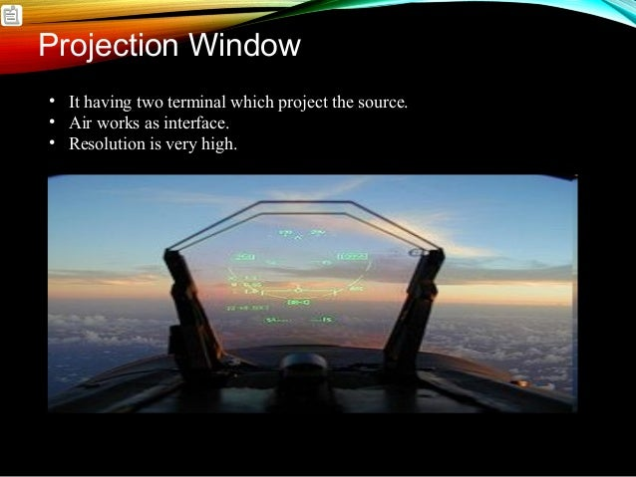
PROJECTION WINDOW
It have two terminal which project the source.
Air works as interface.
Resolution is very high.

Slide 15

RETINAL DISPLAY

Slide 16
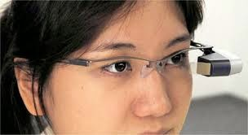
RETINAL DISPLAY
Retinal Display having :
Light projected directly to retina
Prevents snooping
Not limited by physical size
More secure to access data from outsiders.

Slide 17

WORK

Slide 18
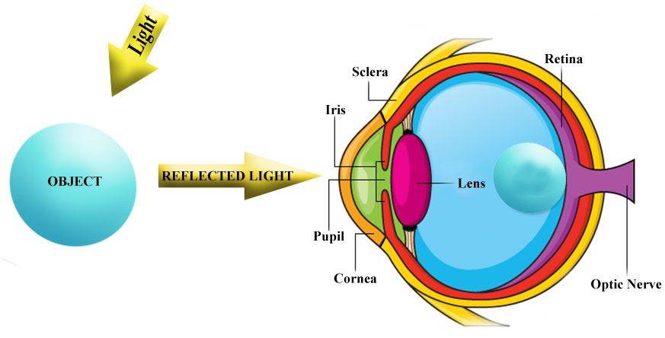
HOW VISION WORKS
We can see things because of reflected light.
Light bounces of an object and enters our eye.
This light then focuses on the retina to form an image.

Slide 19



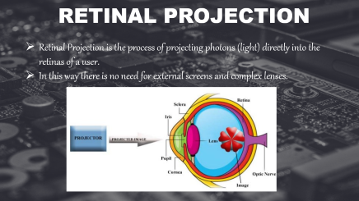
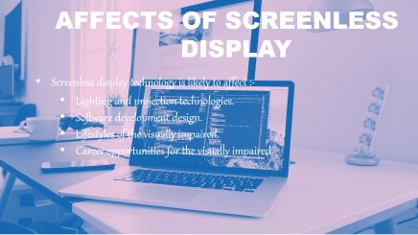
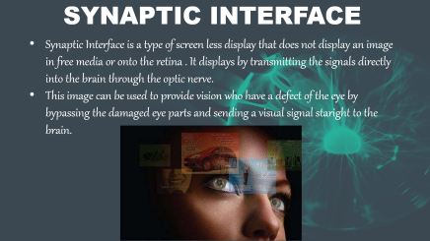


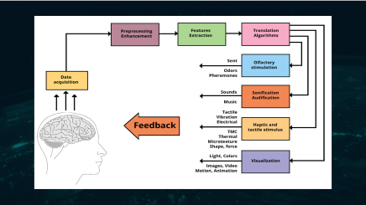


Slide 23

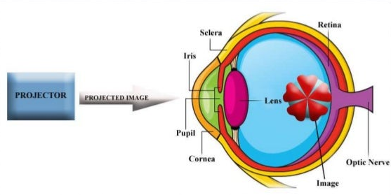
RETINAL PROJECTION
Retinal Projection is the process of projecting photons (light) directly into the retinas of a user.
In this way there is no need for external screens and complex lenses.

Slide 24

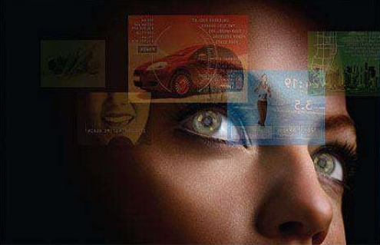
SYNAPTIC INTERFACE
Synaptic Interface is a type of screen less display that does not display an image in free media or onto the retina . It displays by transmitting the signals directly into the brain through the optic nerve.
This image can be used to provide vision who have a defect of the eye by bypassing the damaged eye parts and sending a visual signal staright to the brain.

Slide 25

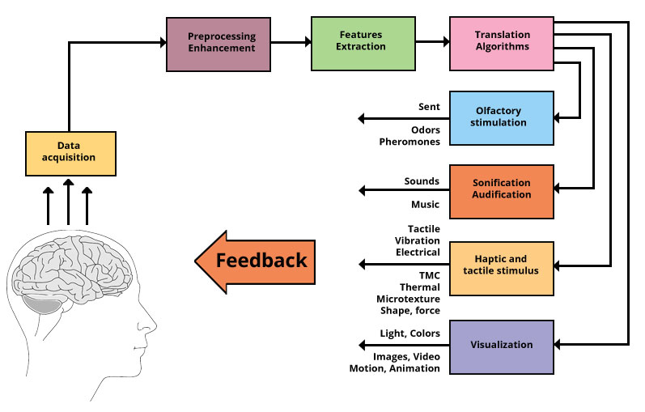

Slide 26

AFFECTS OF SCREENLESS
DISPLAY
Screenless display technology is likely to affect :-
Lighting and projection technologies.
Software development design.
Lifestyles of the visually impaired.
Career opportunities for the visually impaired.

Slide 27
ADVANTAGES OF THE TECHNOLOGY
Greater portability
Wider angle of view
Ability to present 3D images
Lower costs
Low power requirements
Higher resolution images
More accurate color
Greater brightness & better contrast
Ability to present far point images

Slide 28

THANKYOU…

